Slide 1
How to Teach Computers to Recognize Things
Dr. Du Pengfei
Digital Manufacturing Division
Smart Virtual System
June 2024

Slide 2
Overview
Aim:
To have a deeper understanding of how AI works
To get hands on experiences of setting up a typical AI application
Topics of hands-on training computer for object recognition:
Image Classification
Pose Estimation
Object Detection
Individual Learning using Scratch (https://machinelearningforkids.co.uk/#!/worksheets )
Tools needed for each pupils:
1 thumb drive (GS)
1 pcs laptop with built-in camera, internet access and google chrome browser (GS)

Slide 3
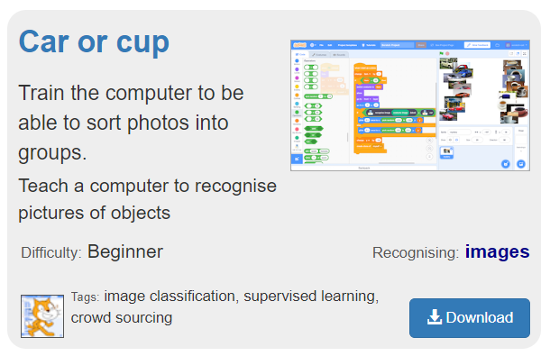
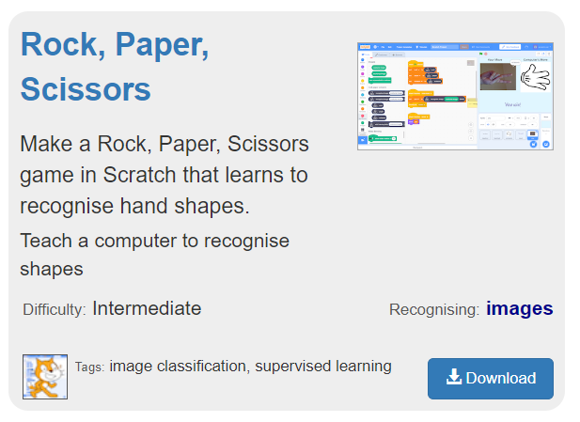
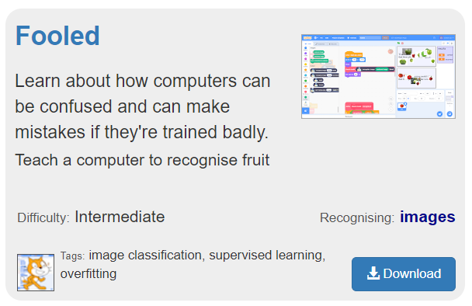
Contents and Schedule
Journey of Four 1.5-hour Sessions:
Date | P5/P6 Session | Hands-on Scratch Project Details
27/6 | What is AI, How and Why? (30-min) Introduction and Briefing Our First AI Program: Image Classification (Two labels): Car OR Cup (60-min) Image collection; Training; Coding. Linked application: Recyclables Sorting; Coin sorting, etc.
4/7 | Dataset Preparation: Building our Perfect “Textbooks” (15-min) Introduction and Briefing Two Hands-on Program: Image Classification (Multiple labels): Fruits Fooled; Rock-Paper-Scissors (75-min) Image collection; Training; Coding. Linked application: Recyclables Sorting; Coin sorting, etc.

Slide 4
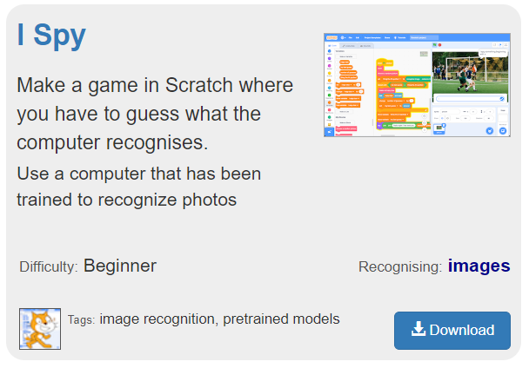
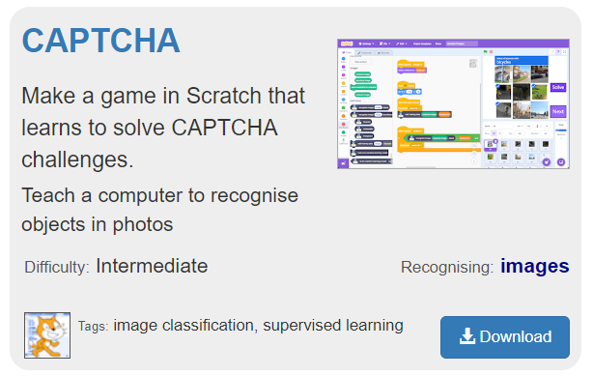
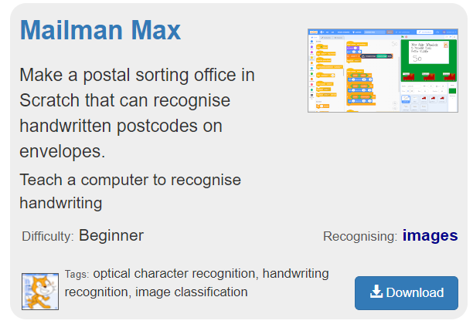
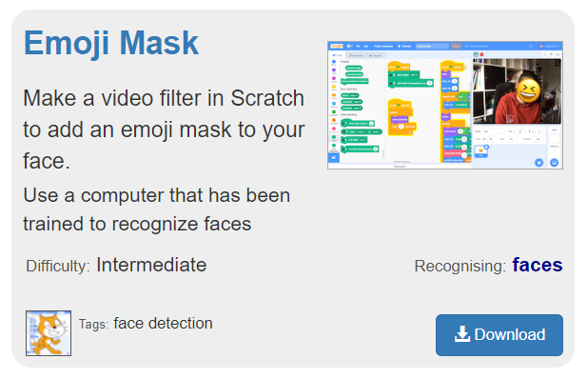
Contents and Schedule
Journey of Four 1.5-hour Sessions:
Date | P5/P6 Session | Hands-on Scratch Project Details
11/7 | Closer-to-reallife AI: Pretrained and Image Recognition (15-min) Introduction and Briefing Two Hands-on Program: Image Recognition: (35-min) I-Spy; Pre-trained model deployment + Coding. (40-min) Captcha; Online Image collection; Training; Coding.
18/7 | Typical Recognition Variants: OCR + Face-detection (15-min) Introduction and Briefing Two Hands-on Program: Image Recognition: (35-min) Mailman_Max; Image collection; Training; Coding. (40-min) Emoji_Mask; Pre-trained model deployment + Coding. Linked application: Hand-writing AI; Facial recognition, etc.

